Slide 1


Slide 2
PRESENTS

Slide 3


Slide 4






Slide 5
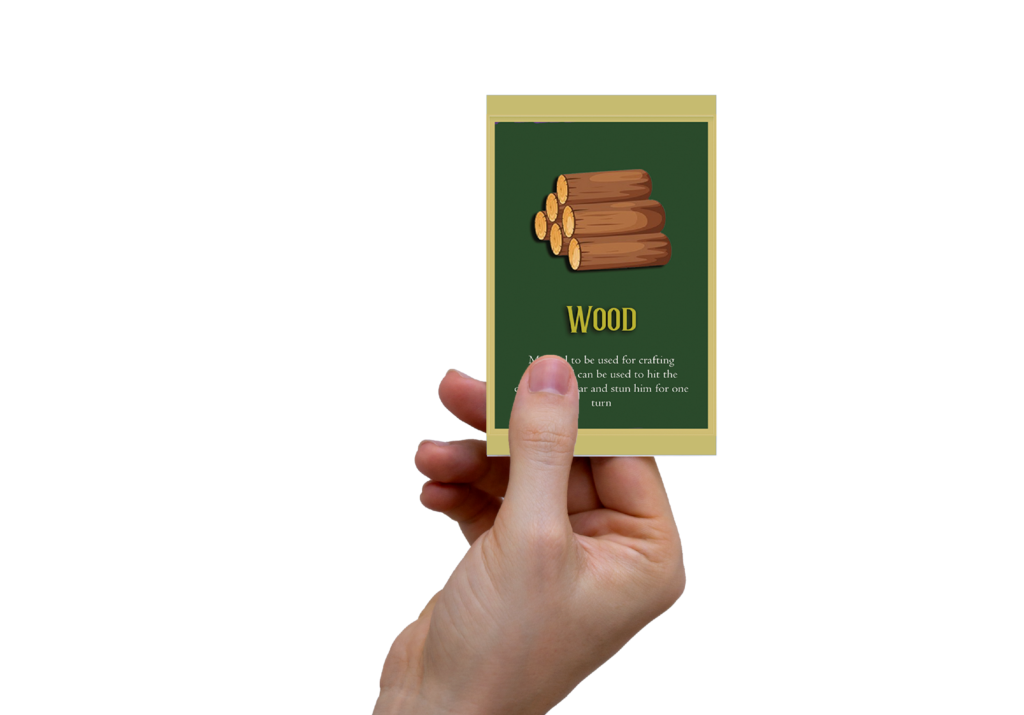


Setup
Game is to be played by 4 players divided into 2 teams, Game consists of 3 different types of
cards –
1) Wonder Cards
2) Trap Cards
3) Material Cards

Slide 6

Premise
Setup
Game is to be played by 4 players divided into 2 teams, Game consists of 3 different types of
cards –
1) Wonder Cards
2) Trap Cards
3) Material Cards

Slide 7
Premise
The motive of our game is to make the player experience the evolution and the wonders of light , player will take on a journey consisting of difficulties and challenges where he will discover different materials which will eventually lead him into discovering the evolutions of light namely – fire , oil lamps, gas lamps & finally the bulb , but well he is not alone the opposing team will also be on the same journey and thus it will be a game of race to the finish , the materials which the player will collect can either be eventually crafted into a wonder card or a trap now the players must strategize and decide where they would want to allocate their materials.

Slide 8
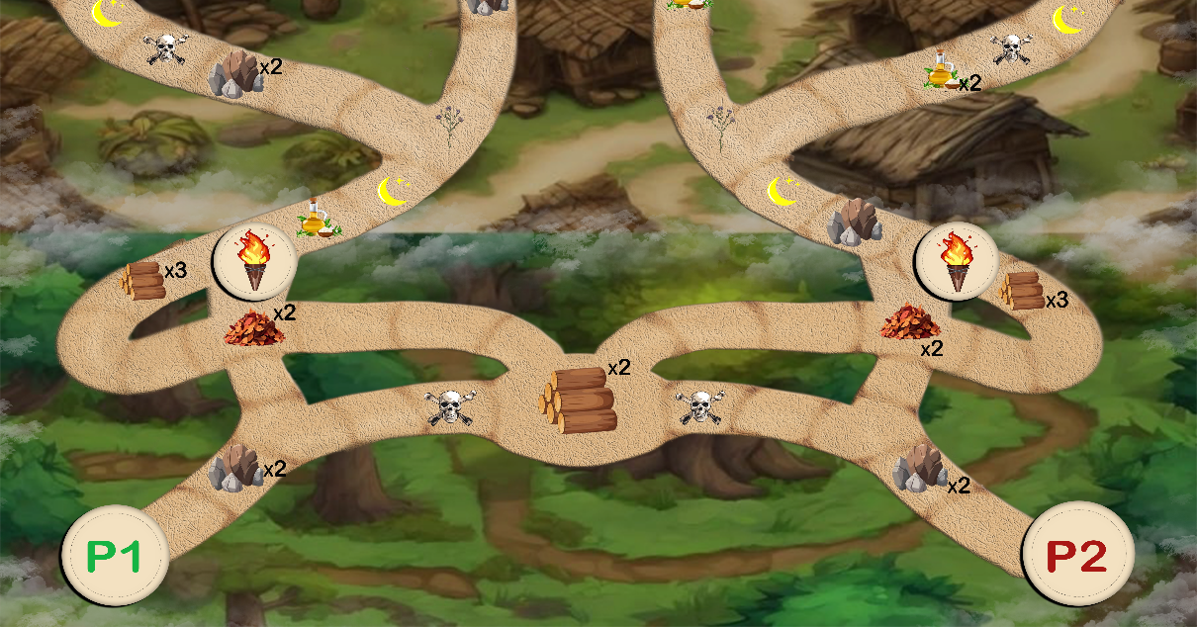
Rules
•From both the teams only one player should be responsible for movement and the other should be responsible for managing the cards
•Each turn you can either craft and use trap cards or you can move your character
•Both the teams should stick to their lane, like team one is the left path whereas team 2 is the right path
•There is no way for a team to take two continuous turns
•Teams should disclose the location where they place the trap card as the opposing team cannot avoid it and will thus keep the game fair
•Player should only move their character to the next possible material or choice or trap, which they choose is for the team to decide
•Once receiving a trap card, the teams must disclose it to the other team
•The materials which are used for crafting must be discarded
•Once a player discovers a wonder card, they can craft it anytime starting from the next stage
•If upon reaching circle checkpoints which denote the end of the stage player does not have the required materials to craft the wonder card they should then return to start of the stage and plan their journey again
•The game ends when either team reaches the end of the journey which is they craft the bulb

Slide 9

How to Play
Before starting both the teams must decide who will be controlling the player, to further explain the character can only be moved by one of the players from each team and the other player will manage the cards, the player who manages the card will be responsible for crafting the traps or wonder cards
•To begin with the teams must decide which will go first and which path will they choose
•Then the player responsible for movement will move the character
The player can only move the character to next possible choice he has, the next possible material or the closest trap the player responsible for movement will decide this, for example in the image below the player when beginning will move to the stone where he will be able to collect it after this, he will move only step as he has the choice to take either left or right

Slide 10
How to Play
•Throughout his journey will encounter signs (skull)
These are traps which cannot be avoided and will cause delay in the player’s journey
•Player will the eventually come to the end where he will have the option to craft the wonder card
The circled part in the image below is where the player can craft the wonder card required to move ahead if the player does not possess the materials required to the craft the said fire, he has to move back to the start

Slide 11
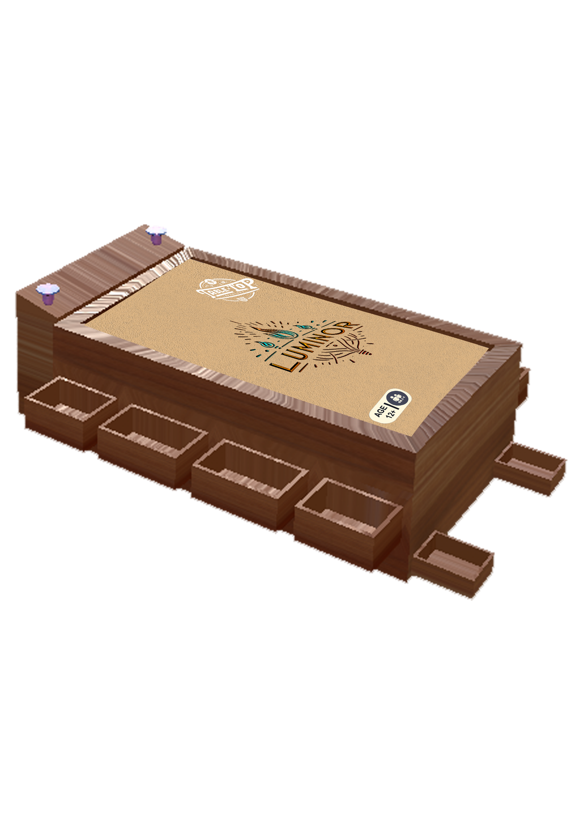


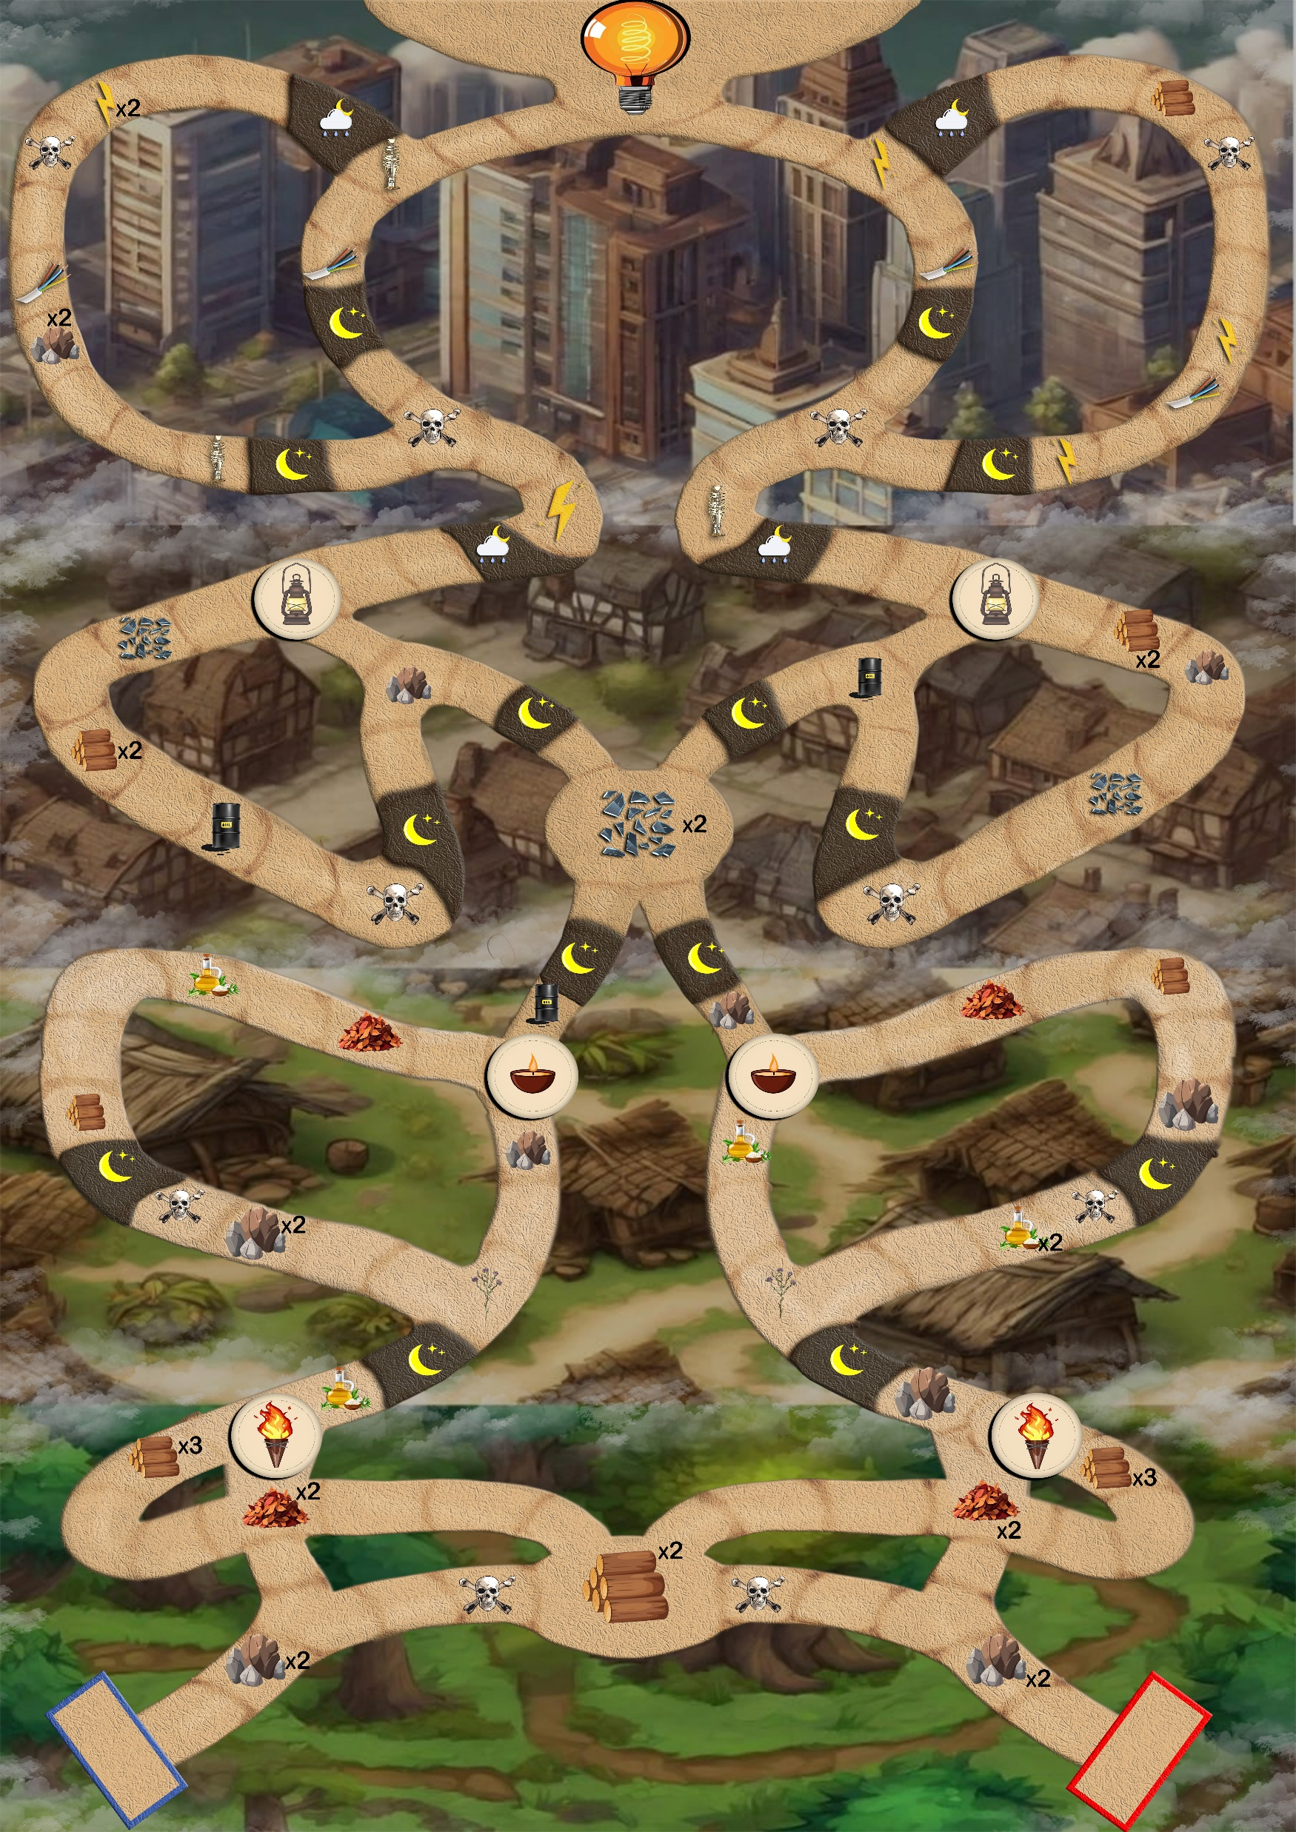
How to Play
•Once the player crafts the wonder card, he or she can move ahead these circled points act as checkpoints and also the end of the stages, so if a player misses to craft the wonder card he or she will return to this checkpoint
•Also, throughout the journey there will be materials which can be taken by both the players whichever player reaches it first will take it and the team which cannot take it will return empty handed
•To keep the game fair whenever the player draws a trap card he must put in back in the deck and shuffle it
•The player should also note that once he crafts either a trap or wonder card, they will lose the materials used for it
•Now coming on traps each chance, the player has either the option to put a trap in the opposing player locations path and since the only way to avoid traps is by taking a different path available on his route and thus the opposing team must strategically decide the location of the traps, if the player has already moved that turn, they cannot put traps and once they have put traps they cannot move

Slide 12
How to Play
•Also to note in stage 3 the player cannot change his route which means if you look at the image below the path to the left is for team 1 and the path to the right is for team 2
•Throughout the journey the player will encounter these icons
These icons signify night the one with the rain is of rainy nights
•To move through these locations one wonder card must be used for normal nights player can simply use fire and oil lamps wonder cards but for the ones with rain they must use the gas lamp wonder card
• The recipe for the wonder cards should be deduced by the teams ( as a fun twist you can have someone else to make the recipes for the wonder cards so keeping the game fresh)

Slide 13



LUMINOR BOARD

Slide 14










GAME CARDS
Wonder cards

Slide 15

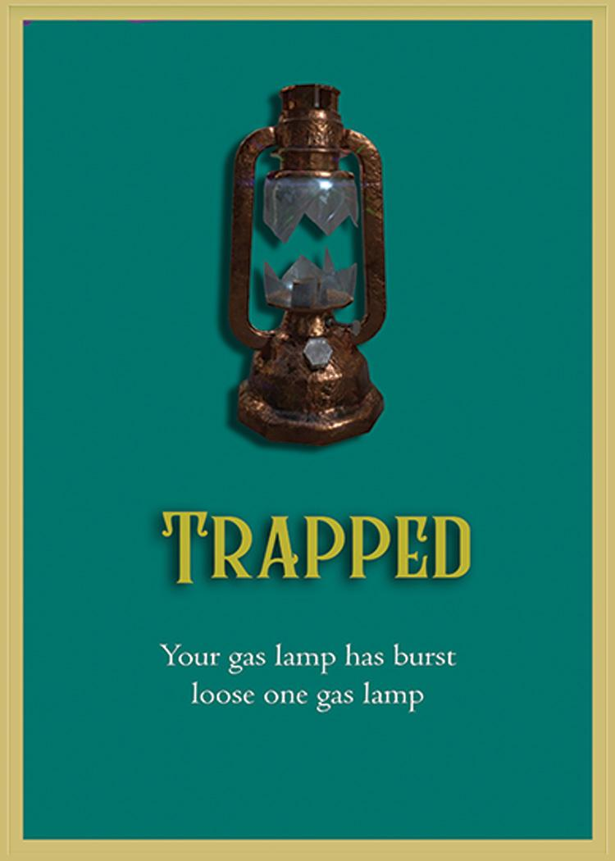




GAME CARDS
Material cards

Slide 16
GAME CARDS
trap cards

Slide 17
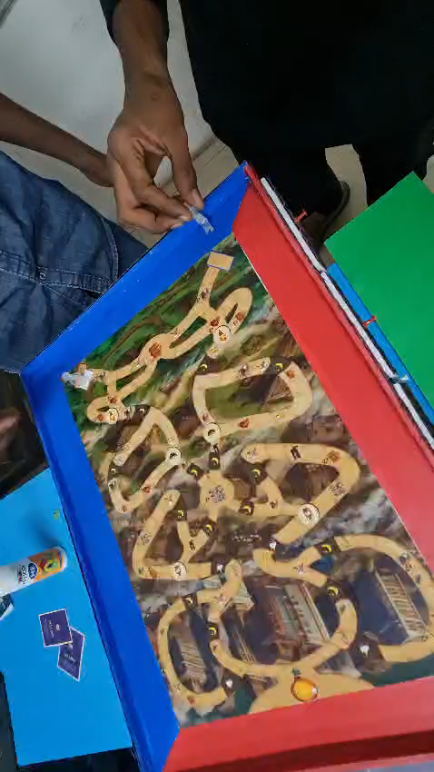
GAME Play

Slide 18
Thank You

